Slide 1
Azure
Platform as a Strategy
@asoursos
@nianton

Slide 2
Strategy is not a discrete event followed by implementation. Strategy is a process that works 24×7 in a company.
-- Clayton Christensen

Slide 3
How strategy works by Clayton Christensen
“If you want to know what a company's strategy is, don't listen to what they say, watch what they do.”
-- Andy Grove
DELIBERATE STRATEGY
Improved understanding of what works and what doesn’t
PROFIT FORMULA
RESOURCE ALLOCATION
STRATEGIC ACTIONS, PRODUCTS, SERVICES
ACTUAL STRATEGY
EMERGENT STRATEGY
Unanticipated opportunities which arise from problems and successes

Slide 4
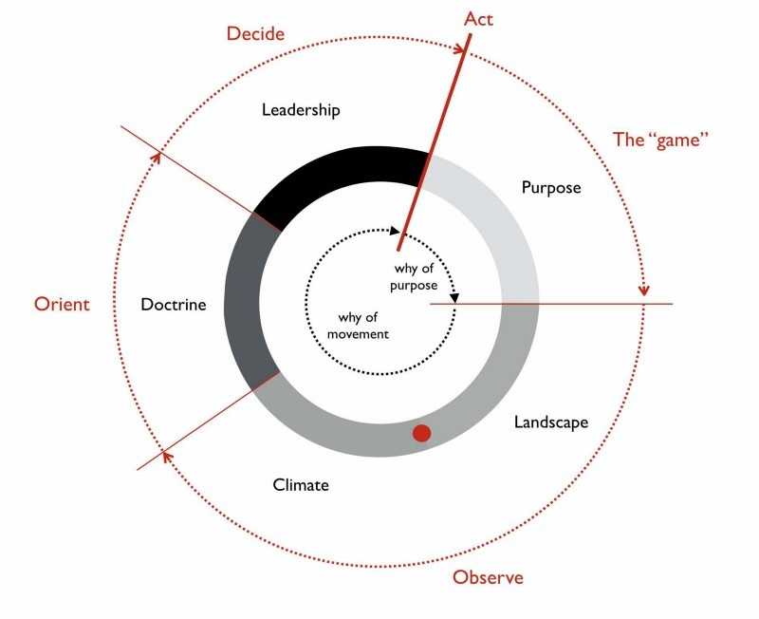
Simon Wardley Strategic Play Sun Tzu + John Boyd (OODA Loop)

Slide 5
Value chain
User Need: Host a website
“A value chain is a set of activities that a firm operating in a specific industry performs in order to deliver a valuable product or service for the market.”
-- Michael Porter
Host Website
Cloud Computing
Data Center
Server

Slide 6
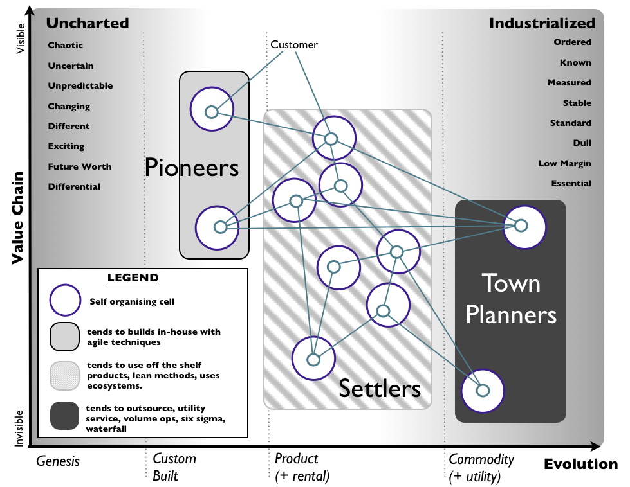
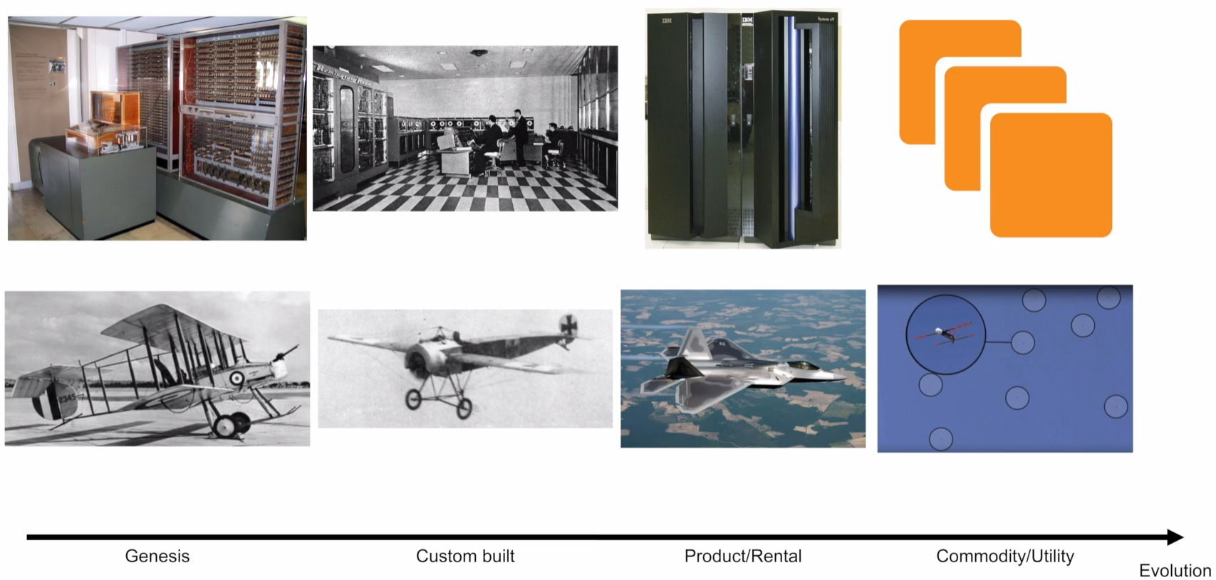
Evolution IT doesn’t matter, by Nicholas Carr

Slide 7
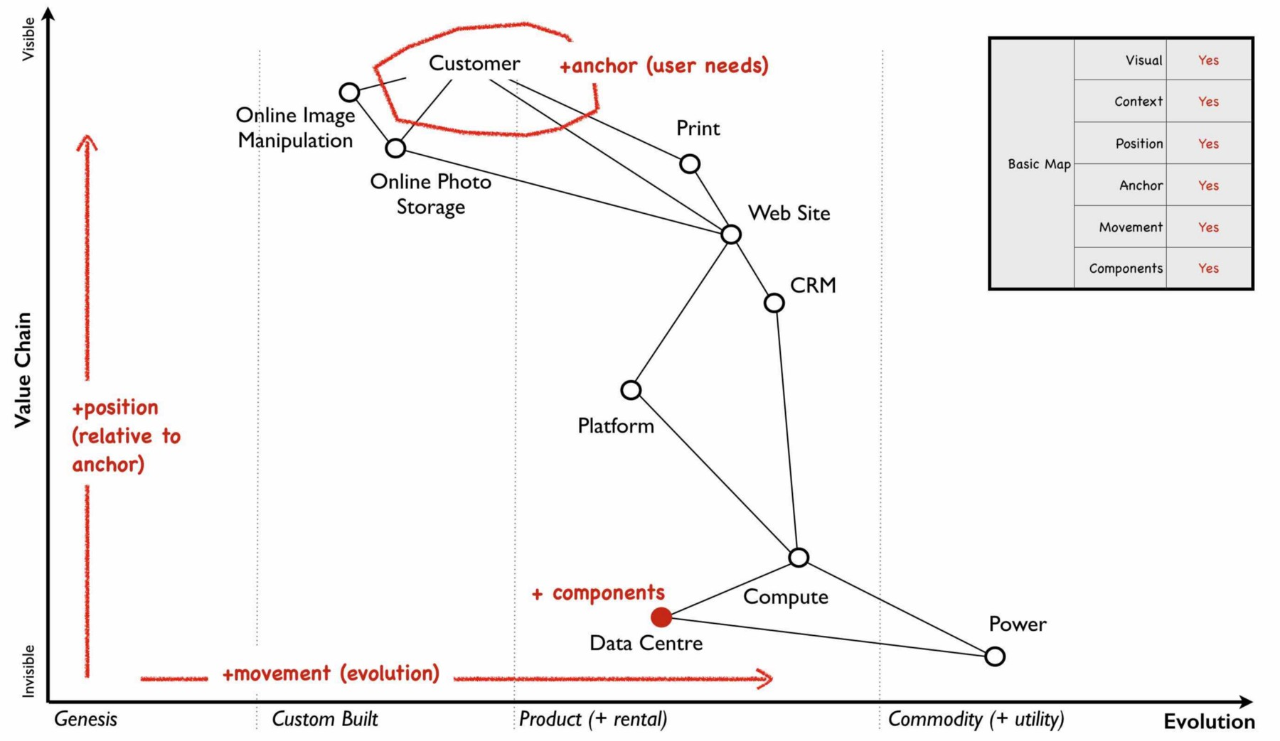
Wardley Maps Value Chain + Evolution

Slide 8
Lets Build a company

Slide 9
EASY TRADE
Help Investors to buy research analysis and trade

Slide 10
Purpose
We’re creating a better form of research analysis and trade
We connect directly investors with analysts
We empower investors reaching a big pool of research
We empower analysts to directly sale their research

Slide 11
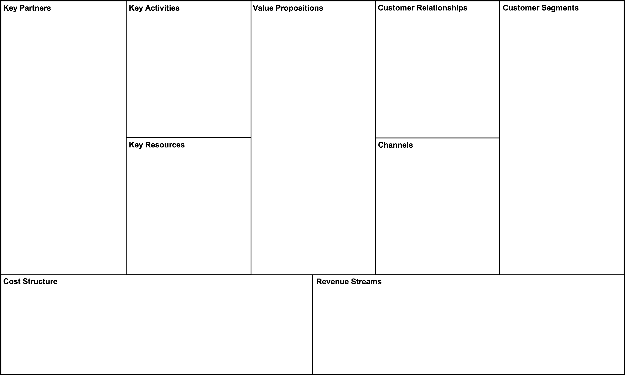
Business Model Canvas
Financial Institution
Fraud Detection Service
Payment Gateway
Consulting Firm (Regulation/Compliance MIFID II)
INVESTOR
Pick and choose feeds to see all the research you want and nothing else
Real-time recommendations
Automatic trading based on rules
MIFID II Compliant
ANALYST
Reach a pool of investors for free
Paid per view/use of your analysis
GET Ads, Partnerships, Communities, FinTech Events
KEEP
Customer Service
GROW
Referral Program
Analysis
Trading
Recommendation Engine
INVESTOR
RESEARCH ANALYST
STAKEHOLDERS
External:
Regulators
Tax Office
Investors List
Research Analysts List
Website
Regulation and Compliance
Product Development
Hosting/Data Center
Other costs
Investor pays analysis reports per view/use
Investor pays commission per trade
Investor pays recommendation analysis

Slide 12
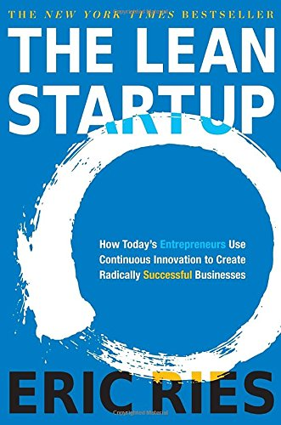
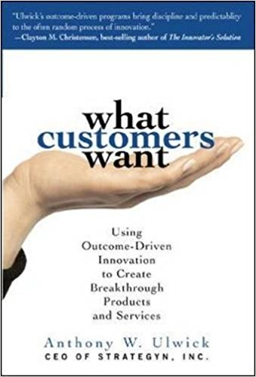
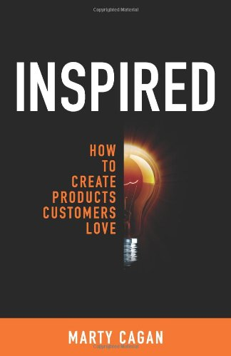
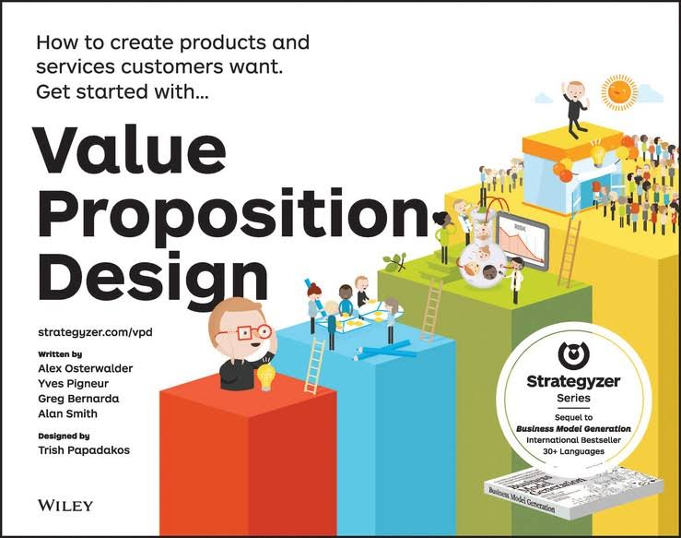
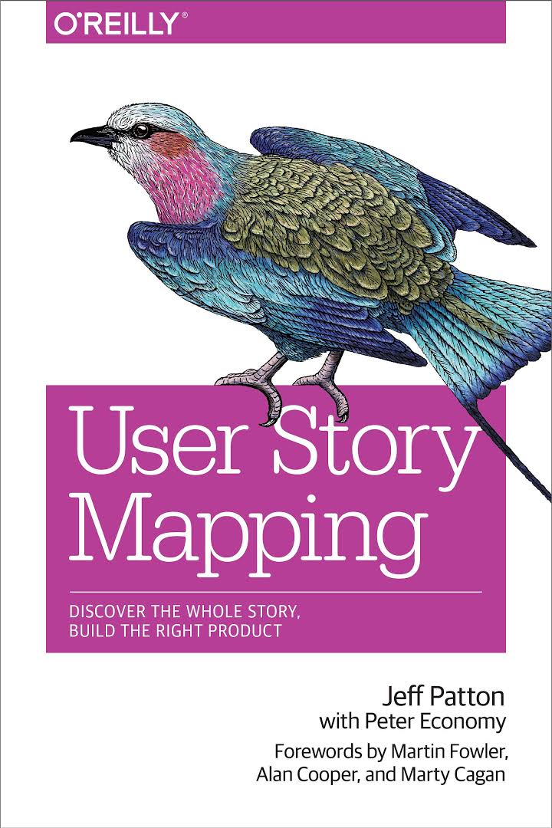
Approach Value is NOT validated
Cross functional team
Agile Methodology
Lean Startup (Build/Measure/Learn)
Value design proposition based on Jobs-to-be-done (JTBD)
Test features for value
Close communication with customers
Experimenting – Bets
Minimum Viable Product (Story Mapping)

Slide 13
Value Chain
Investor
Analyst
Place my analysis
Manage Analysis Portfolio
Find best analysis
Trade
Web App
Web App
Web Service
Web Service
Data
Technology Stack
Data
Technology Stack

Slide 14
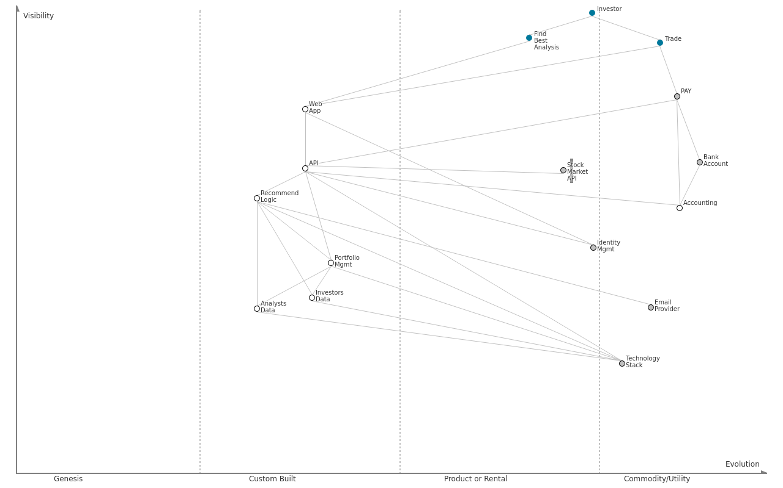
Wardley Map Easy Trade as a Custom Build
For each component ask:
How ubiquitous and well defined is the component?
Do all my competitors use such a component?
Is the component available as a product or a utility service?
Is this something new?

Slide 15
Azure How can I help you?
Help me setup a development and test environment as soon as possible
Infrastructure-as-a-Service and Platform-as-a-Service offerings
Help me setup my experiments and (in)validate my hypothesis easily – A/B Testing, Opt-in, Opt-out
Application Insights: Metrics
Help me move fast to the market with quality
Visual Studio Team Services: Continuous Delivery Pipeline
I need a robust and high availability billing system
Sql Azure
I need a low-latency, scalable and flexible storage for my analysis documents
Cosmos Db
Help me authenticate and authorize my users with security best practices
I am obliged to be compliant for my users’ personal data (EU directive, 2018)
Active Directory B2C
Help me with customer service
“Hire” a CRM offering that fit your needs in Marketplace (Dynamics 365, Salesforce)
I need a cost effective storage for my file storage and user preferences
Azure Storage (Blob / Table)

Slide 16
Demo
App Service, Application Insights, Continuous Delivery

Slide 17
We are useful!
Congratulations, now it’s the time to build a product.

Slide 18
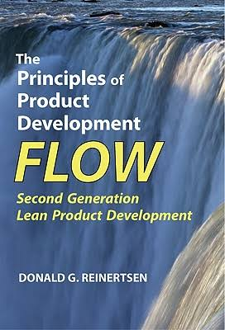
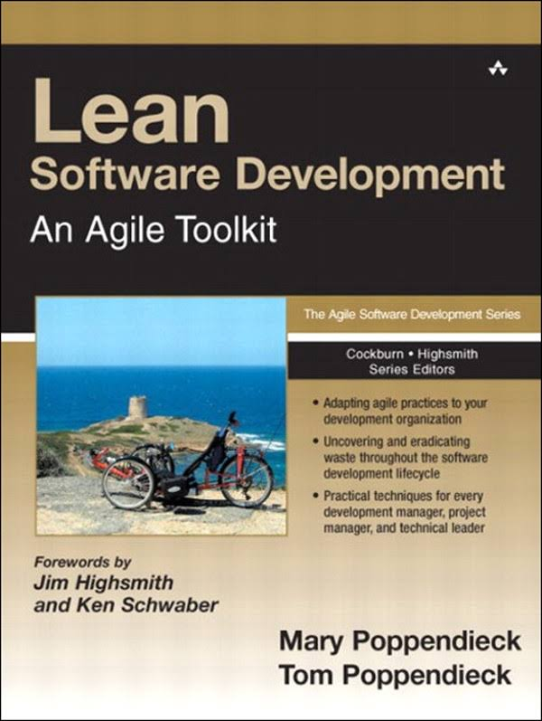
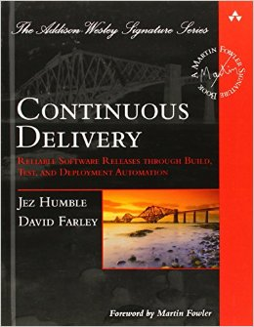
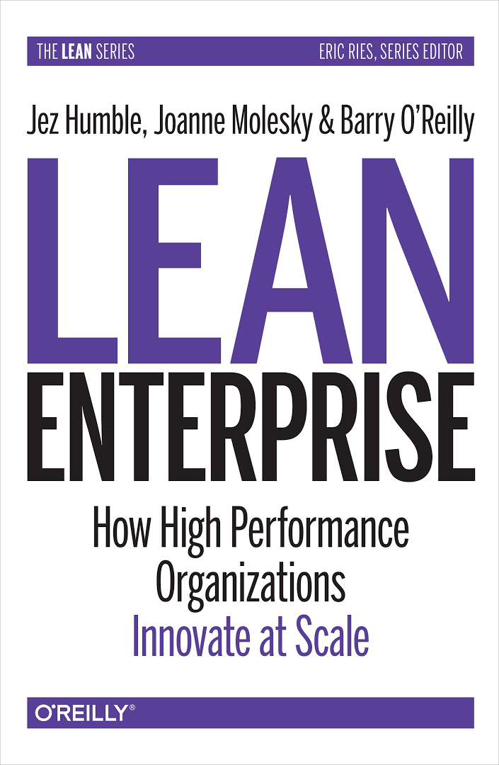
Approach Value is validated.
Focus shifts from inventing to improving
Prioritize with an Economic Framework (Cost of delay, Cycle Time)
Lean/Theory Of Constraints (TOC) Methodology
Continuous Delivery
Trunk-based Development Branch By Abstraction, Feature Toggle, Ready to release

Slide 19

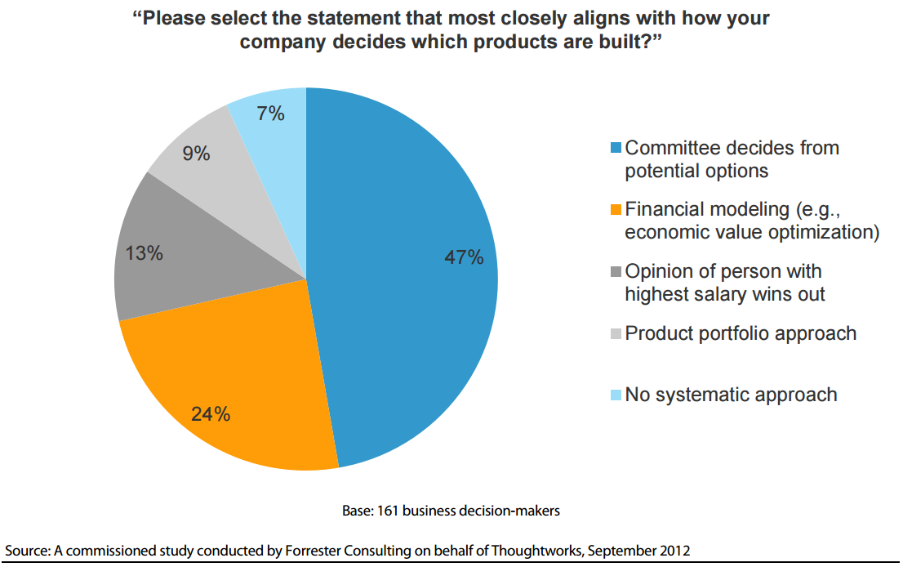
How we prioritize

Slide 20

Coin Game

Slide 21
Azure How can I help you?
Help me have orchestrate a decoupled architecture (DDD / Microservices) that is component-based
Azure Functions, Service Fabric, Container Service
I need scalability for my components to handle future growth, my peak loads
Scale-up or Scale-out (preferably) on demand
Automate resource allocation to minimize cost during low usage, maximize capacity and performance when required
I need to move fast to similar or emerging markets
Cosmos DB (available in 34+ regions) with data-replication
I want to be language/technology independent, so I can have a broad talent pool
Most open source platforms supported as Infrastructure as Service
Keep components using different technologies working together in a coherent ecosystem

Slide 22
Demo
App Service, Cosmos Db, Scaling

Slide 23
We are successful!
Congratulations, now it’s time to find something new.

Slide 24
Any strategy is (at best) only temporarily correct.
Skate to where the money will be.
-- Clayton Christensen

Slide 25
We have to move
Success breeds inertia
Inertia increases the more successful the past model is
Inertia can kill an organization
We want to find new ways of attracting new markets with new products or services
Competition evolves too
We should adapt and not stand still (Red queen effect)

Slide 26
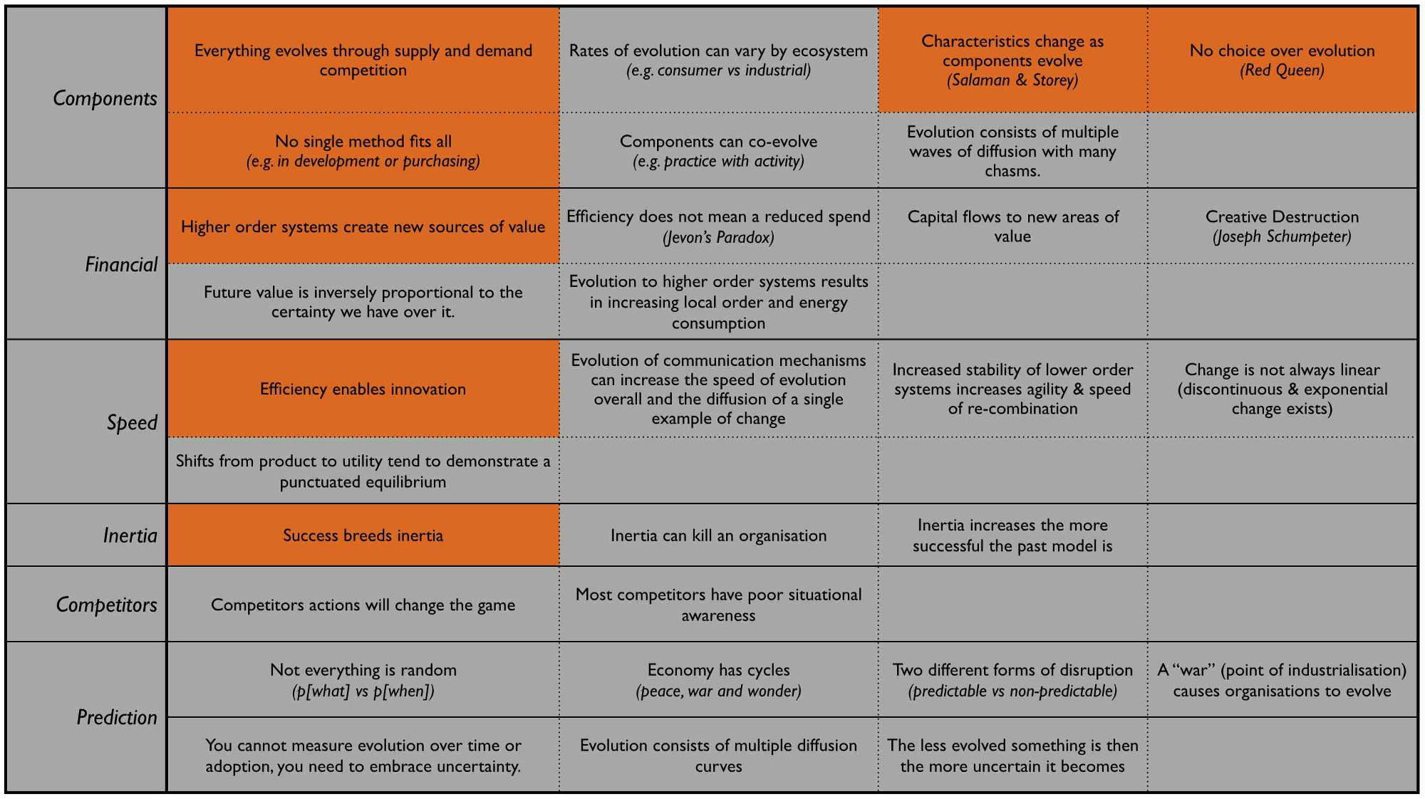
Climate

Slide 27
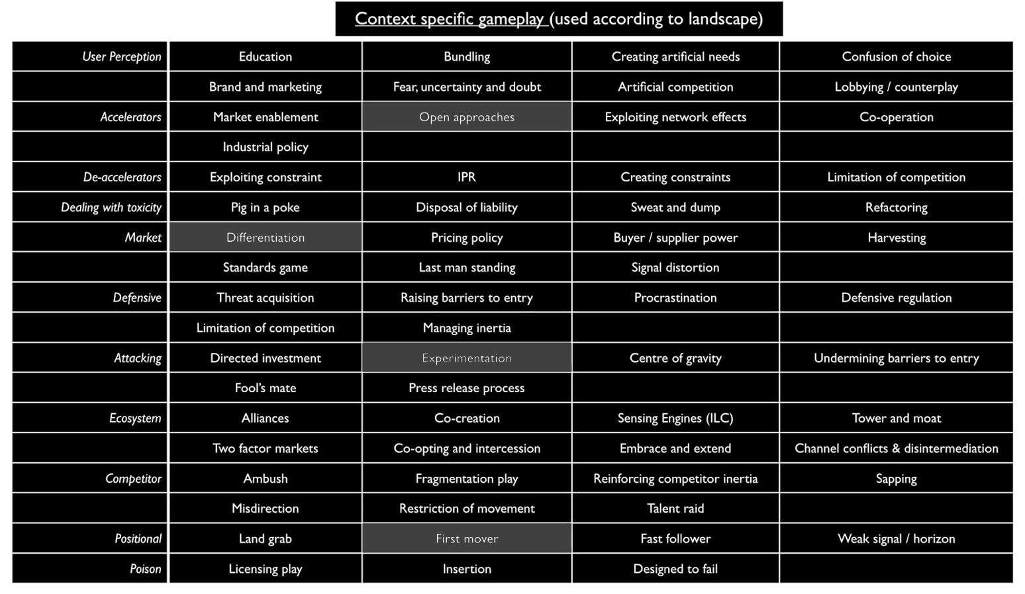
Doctrine

Slide 28
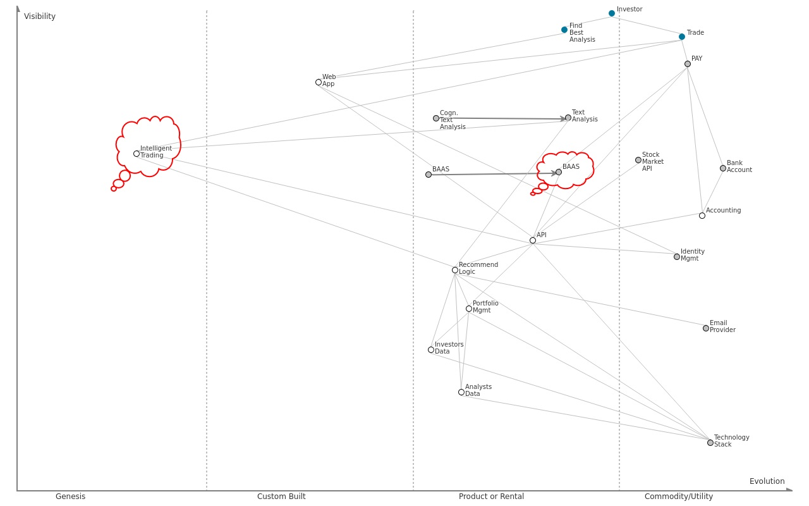
Wardley Map Apply Climate and Doctrine Patterns

Slide 29
Azure: How can I help you?
I need to make my API public and consumable in various modes, so I can accelerate my growth
Azure API Management
I need to support as an experiment transactions using BlockChain
Blockchain as a Service (Baas)
I have to transform my recommendation engine to be intelligent
Use various offerings of Cognitive Services as a base for my custom built Machine Learning model
Expose my ML model as an easy to consume API

Slide 30
Approach Value is determined
Focus shifts to volume operations
What counts is volume and stability
Six Sigma
Data-driven
Reduce deviations
Enable high-order systems to build upon

Slide 31
Takeways
Cloud computing is the new utility, the way of doing business
IT isn’t a cost department, but an innovation department
Focus on user needs - JTBD
Create the Value Chain
Build a Map
Think – Where and Why to attack
Methods – Examine different approaches with different maps
No one size fits all
Deliver frequently and get feedback

Slide 32
References
Clayton M. Christensen, Michael E Raynor – Innovator Dilemma, Innovator Solution
Alexander Osterwalder, Yves Pigneur - Value Proposition Design, Business Model Generation
Antony Ulwick – What customers want, Jobs to be done
Simon Wardley – Wardley Maps
Eliyahu M. Goldratt - The Goal: A Process of Ongoing Improvement
Donald Reinertsen – Managing the Design Factory, Product Development Flow
Mary Poppendieck, Tom Poppendieck - Lean Software Development, Leading Lean Software Development
Joshua Arnold, Ozlem Yuce - Black Swan Farming Using Cost of Delay (IEEE), http://blackswanfarming.com
Eric Ries - Lean Startup
Marty Cagan - Inspired: How to Create Products Customers Love
Jeff Patton - Story Mapping
Gojko Adjic - Specification By Example
Jez Humble, David Farley – Continuous Delivery, Lean Enterprise
Eric Evans – Domain Driven Design
Alistair Cockburn – Hexagon Architecture
Test in production - Online Experimentation at Microsoft
Code - https://github.com/asoursos/azure-strategy

Slide 33
Thank You!

